Slide 1
Lending Club Case Study

Slide 2
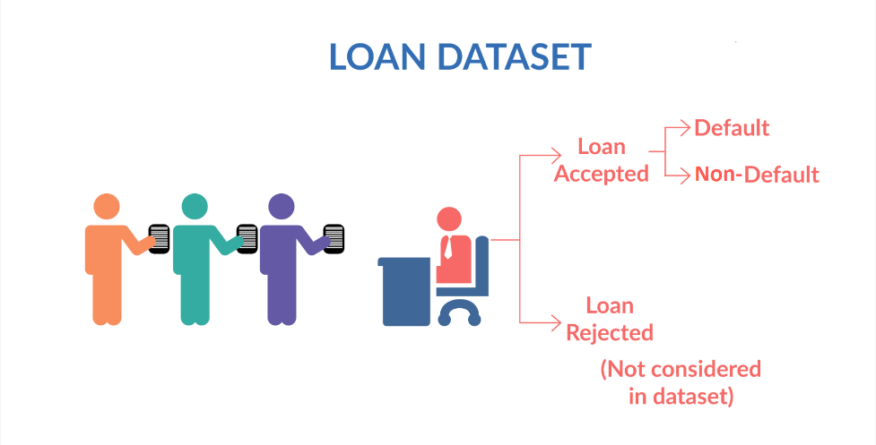
Lending Club Case Study
Business Understanding:
When the company receives a loan application, the company has to make a decision for loan approval based on the applicant’s profile. Two types of risks are associated with the bank’s decision:
If the applicant is likely to repay the loan, then not approving the loan results in a loss of business to the company
If the applicant is not likely to repay the loan, i.e. he/she is likely to default, then approving the loan may lead to a financial loss for the company

Slide 3
Business Objective
Company is the largest online loan marketplace, facilitating personal loans, business loans, and financing of medical procedures. Borrowers can easily access lower interest rate loans through a fast online interface.
Like most other lending companies, lending loans to ‘risky’ applicants is the largest source of financial loss (called credit loss). Credit loss is the amount of money lost by the lender when the borrower refuses to pay or runs away with the money owed. In other words, borrowers who default cause the largest amount of loss to the lenders. In this case, the customers labeled as 'charged-off' are the 'defaulters'.
If one is able to identify these risky loan applicants, then such loans can be reduced thereby cutting down the amount of credit loss. Identification of such applicants using EDA is the aim of this case study.
In other words, the company wants to understand the driving factors (or driver variables) behind loan default, i.e. the variables which are strong indicators of default. The company can utilize this knowledge for its portfolio and risk assessment.

Slide 4
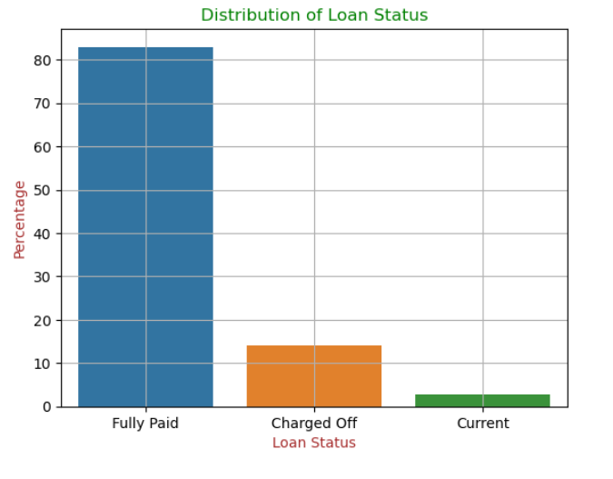
Overall Loan Status
85% individuals have paid there loans
15% people have been charged off
5% loans are active.

Slide 5
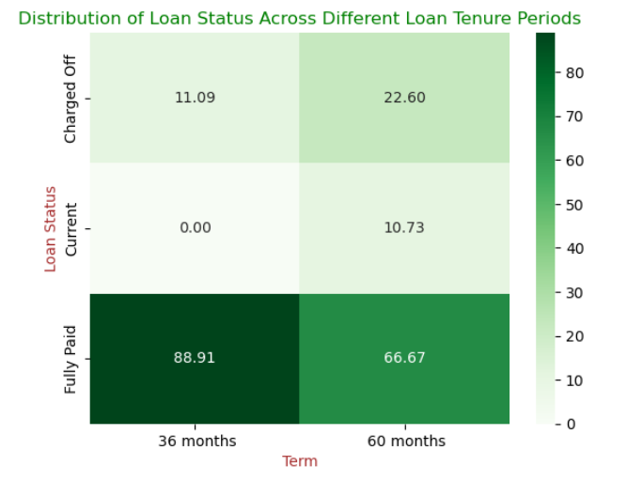
Loan Status Analysis by Tenure
The analysis shows that shorter loan tenures are more often fully paid off, as borrowers with shorter repayment periods tend to manage their financial obligations better.
In contrast, longer loan tenures carry a higher risk of default. Over extended periods, borrowers are more likely to face financial challenges or increased interest burdens, leading to a greater likelihood of default.
This highlights that while longer tenures may offer lower monthly payments, they come with a significantly higher risk, which should be carefully considered in lending decisions.

Slide 6
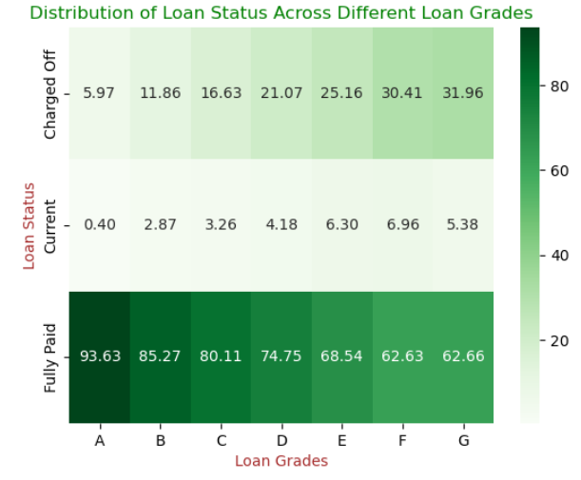
Loan Status Analysis by Grade
Loans graded A and B show the highest rates of full repayment, indicating lower risk and greater reliability.
As loan grades decline from A to G, there is a noticeable decrease in fully paid loans and an increase in charged-off loans.
Lower-grade loans, especially those in grades F and G, are more prone to default, reflecting higher risk.
Higher-grade loans are more dependable, while lower-grade loans are significantly riskier and more likely to result in losses.

Slide 7
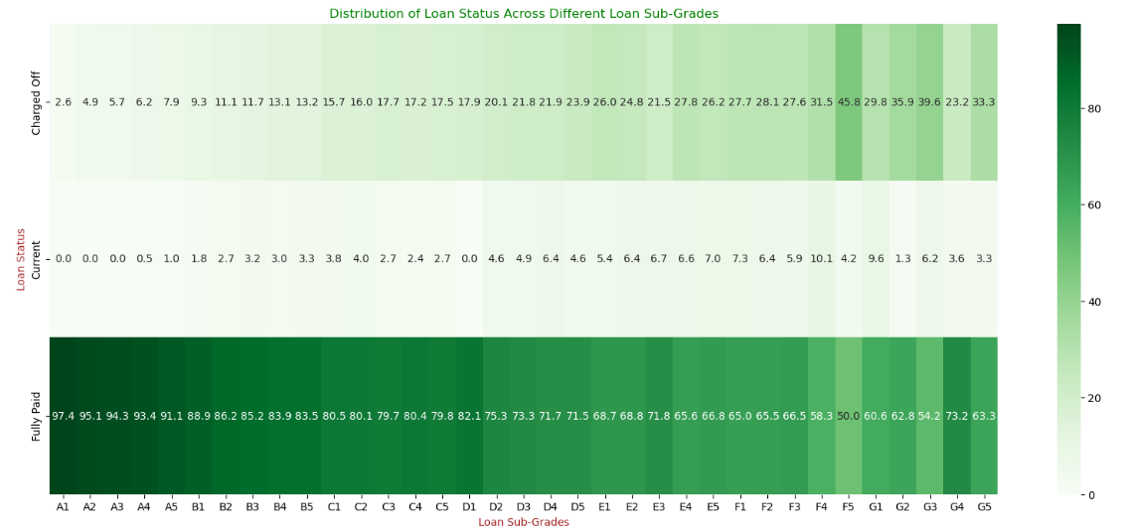
Loan Status Analysis by Sub-Grade
Higher sub-grades (A1 to B5) consistently show a greater number of fully paid loans, reflecting a lower risk and higher repayment success.
In contrast, lower sub-grades (F5, G3, G5) demonstrate an increase in charged-off loans, indicating a higher likelihood of default.
This pattern suggests that loans with higher sub-grades are generally more reliable, while those with lower sub-grades carry a significantly higher risk of default.

Slide 8
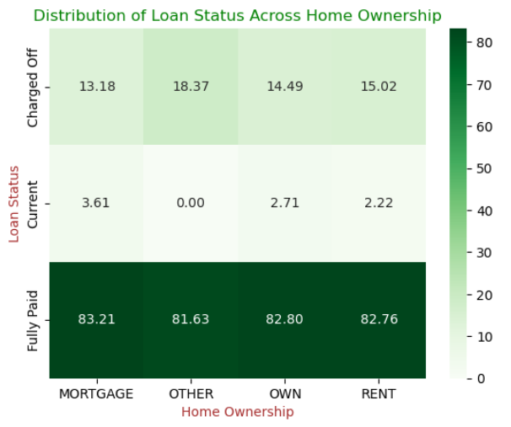
Loan Status Analysis by Home Ownership
There’s a strong correlation between homeownership and successful loan repayment.
Individual with an "Other" homeownership status have the highest number of charged-off loans, indicating a higher risk of default.
Homeowners (mortgage and own) and renters have significantly lower charge-off rates and higher rates of fully paid loans.
Homeownership plays a crucial role in loan repayment behavior, with those in the "Other" category being more likely to default.

Slide 9
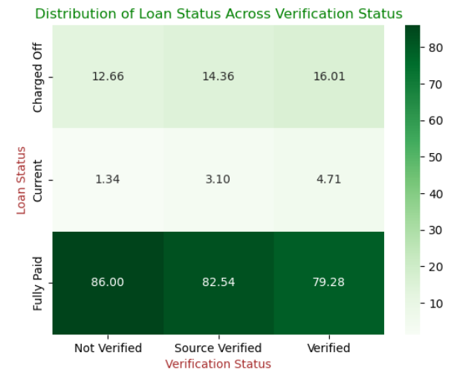
Loan Status Analysis by Verification Status
Verification status strongly correlates with loan repayment outcomes.
Non-verified individuals have the highest proportion of fully paid loans, indicating better repayment behavior.
Conversely, loans involving verified individuals show a higher rate of being charged off, suggesting a greater risk of default.
This data implies that verification status significantly affects loan outcomes, with verified individuals being more likely to default than non-verified ones.

Slide 10
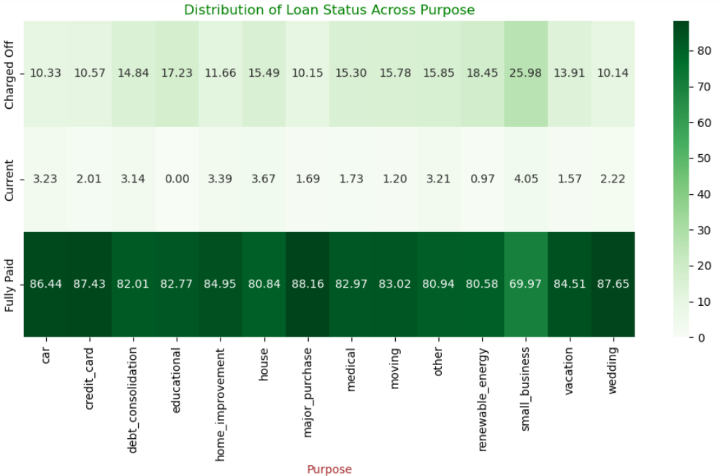
Loan Status Analysis by Purpose
Individuals who take loans for weddings, major purchases, credit cards, or cars are most likely to repay their loans.
The purpose of the loan is strongly related to its repayment outcome.
Loans for small businesses or education purposes carry a higher risk of default, making these borrowers more likely to not repay.

Slide 11
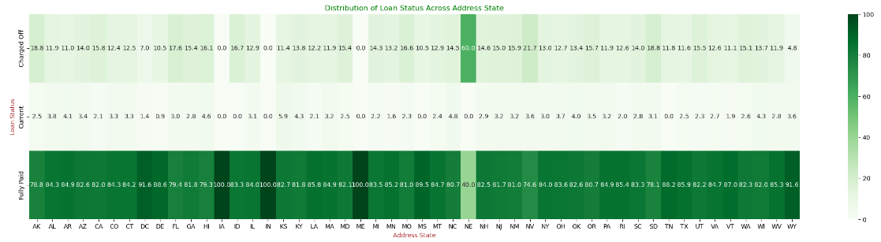
Loan Status Analysis by Address State
Loans in IA, IN, and ME have the highest percentage of being fully paid, with zero defaults, indicating strong repayment behavior.
Individuals from IA, IN, and ME are highly reliable borrowers and are very likely to repay their loans.
In contrast, NV shows the highest charge-off rate, indicating a higher likelihood of default among borrowers.
Borrowers from NE also present a higher risk, being more likely to default on their loans.

Slide 12
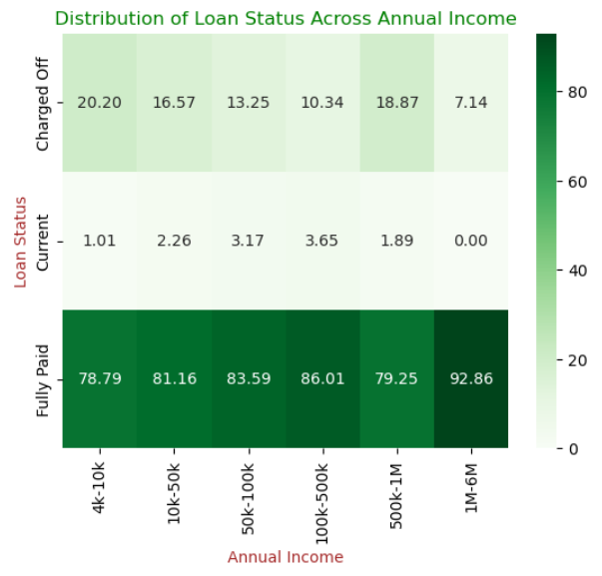
Loan Status Analysis by Annual Income
Higher annual income is strongly correlated with better loan repayment behavior.
Borrowers with incomes between 1M-6M have significantly higher rates of fully paid loans, indicating strong repayment reliability.
Borrowers with incomes between 4K-10K, as well as those earning 500K-1M, show significantly higher rates of charged-off loans, indicating a higher risk of default.
Income level is a crucial factor influencing loan repayment outcomes.
Loans given to individuals with annual incomes between 4K-10K are riskier and more likely to result in default, while individuals with incomes above 1M are more likely to repay their loans.

Slide 13
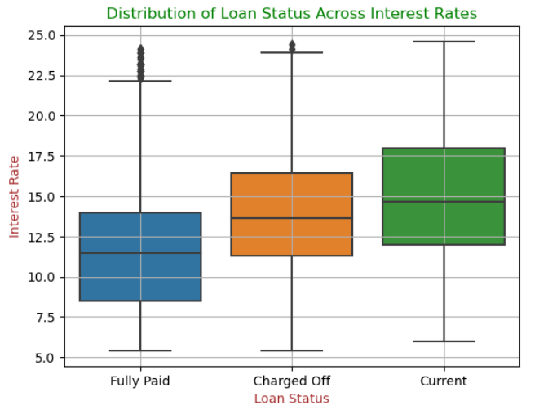
Loan Status Analysis by Interest Rate
Interest rates significantly impact loan status, with higher rates being linked to a larger proportion of charged-off loans and fewer fully paid loans.
This suggests a strong correlation between higher interest rates and increased loan repayment risk.
Loans with higher interest rates have a greater likelihood of default, making them riskier for lenders.

Slide 14
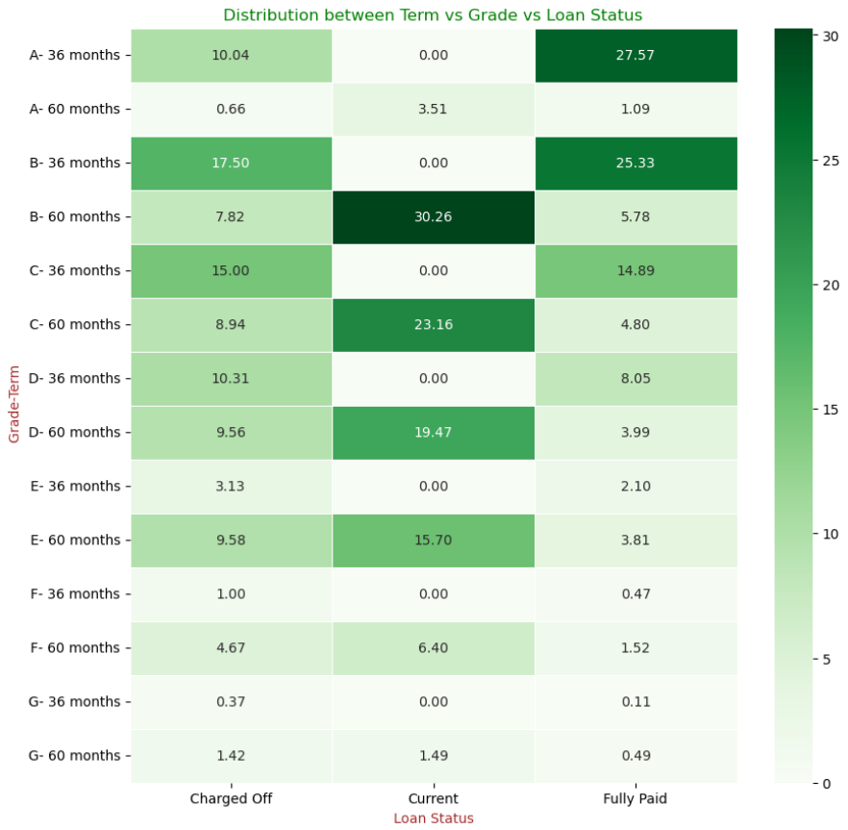
Loan Status Analysis by Term and Grade
Grade A and B loans with a shorter 36-month tenure have a higher likelihood of being fully paid off.
In contrast, Grade B and C loans with the same 36-month tenure are more prone to being charged off.
For ongoing loans, Grade B, C, D, and E loans with longer tenures are riskier and more likely to default.
Historical data shows that the charge-off percentage for these grades with longer tenures is higher than the percentage of fully paid loans, indicating greater default risk.

Slide 15
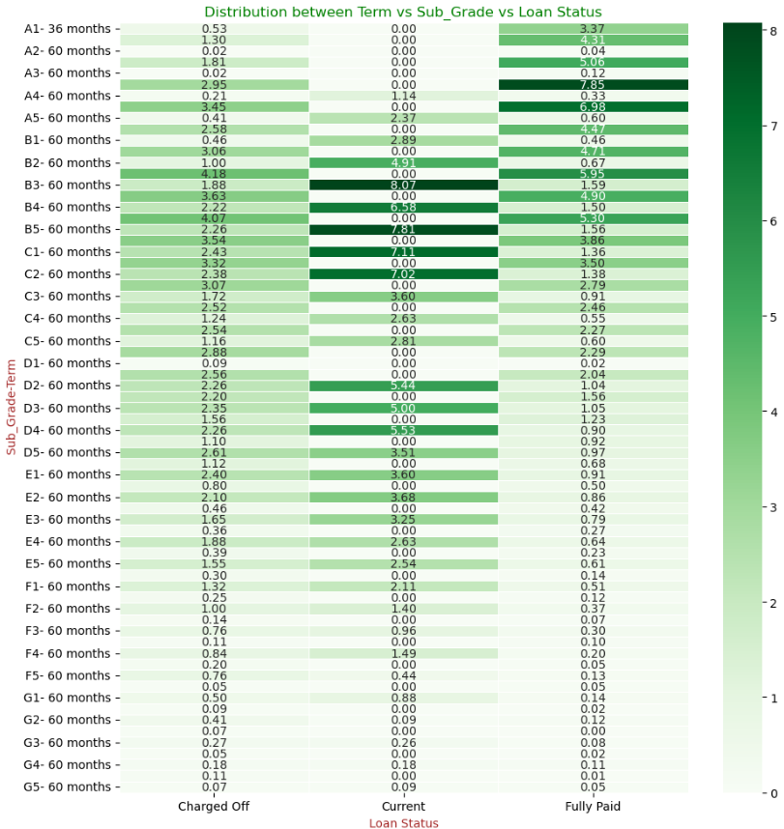
Loan Status Analysis by Term and Sub-Grade
Sub-grades A3 and A4 with a longer 60-month tenure have a higher likelihood of resulting in fully paid loans.
In contrast, sub-grade B4 with a 60-month tenure is more likely to be charged off.
For ongoing loans, sub-grades B3, B5, C1, and C2 are riskier and more likely to default.
Historical data shows that the charge-off percentage for these sub-grades is higher than the percentage of fully paid loans, indicating greater default risk.

Slide 16
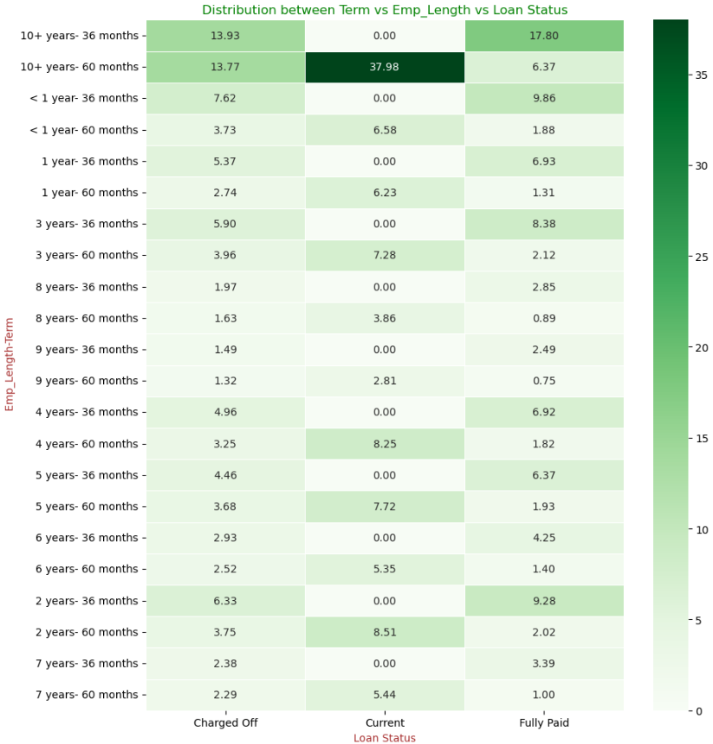
Loan Status Analysis by Term and Experience
Individuals with 10+ years of experience are most likely to fully repay loans when the tenure is shorter.
However, for longer tenure loans, the charge-off rate increases significantly for these individuals.
For ongoing loans, individuals with 10+ years of experience and longer tenures are riskier and more likely to default.
Historical data suggests that longer tenure loans for experienced individuals carry a higher risk of default.

Slide 17
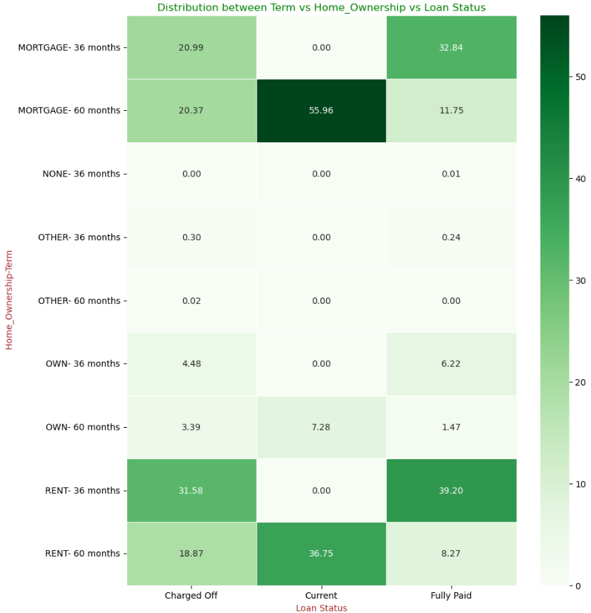
Loan Status Analysis by Term and Home Ownership
Individuals who rent and have short loan tenures are most likely to fully pay off the loan but also show a similar trend in loan charge-offs.
Homeowners with a mortgage and longer loan tenures are more likely to default.
Renters with longer loan tenures are also at a higher risk of default

Slide 18
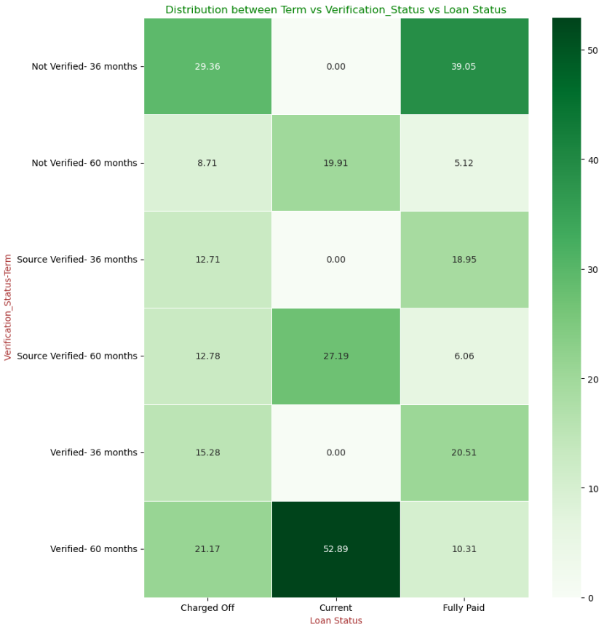
Loan Status Analysis by Term and Verification Status
Not verified individuals with shorter loan tenures show a strong tendency to repay their loans and a moderate likelihood of experiencing a charge-off.
Individuals with ongoing loans and longer tenures are at higher risk of default, regardless of verification status.

Slide 19
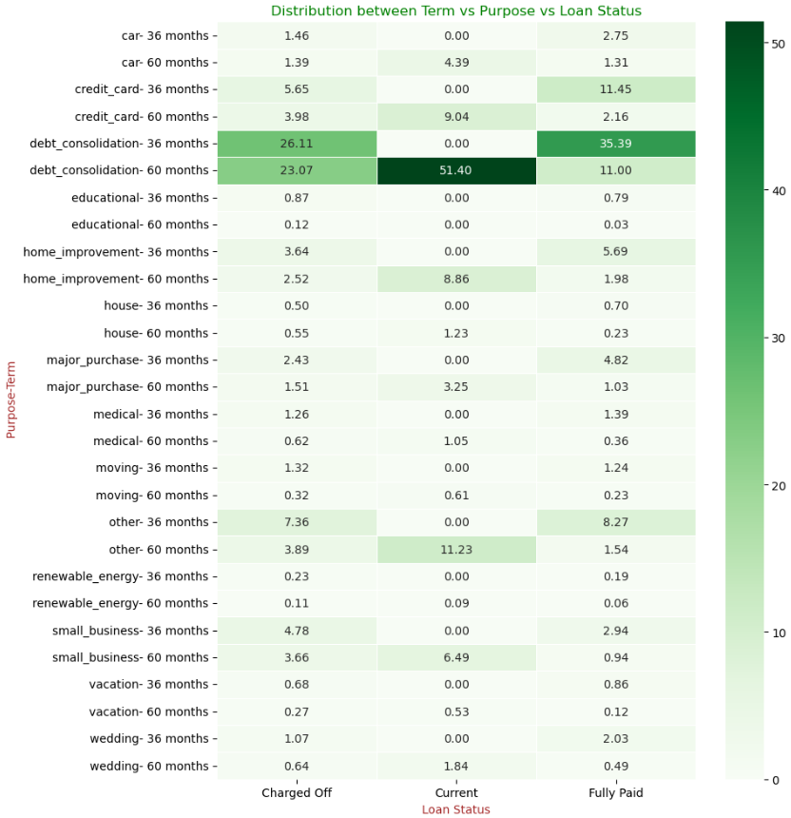
Loan Status Analysis by Term and Purpose
Individuals who applied for debt consolidation with shorter loan tenures show a strong tendency to repay their loans.
These same individuals also have a moderate likelihood of experiencing a charge-off.
Individuals with ongoing loans for credit card, debt consolidation, home improvement, small business, and other purposes with longer tenures are at higher risk of default.

Slide 20
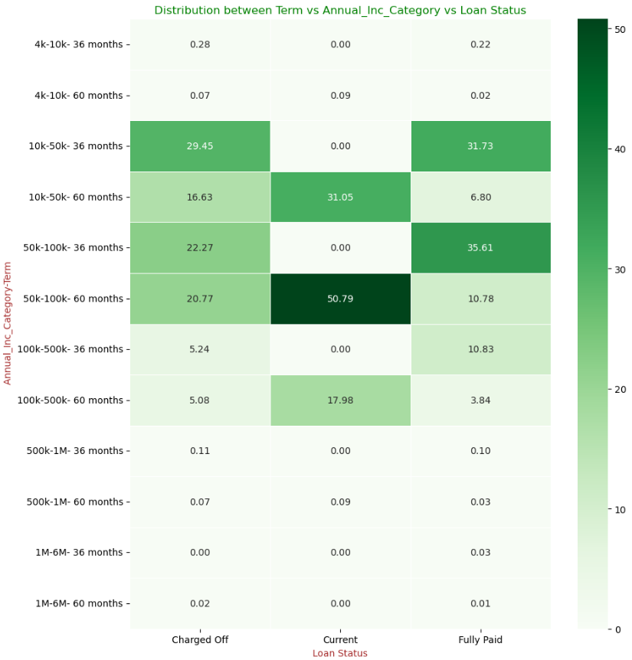
Loan Status Analysis by Term and Annual Income
Individuals earning 50k-100k with shorter loan tenures are most likely to repay their loans.
Individuals earning 10k-50k with shorter loan tenures are more likely to be charged off.
For ongoing loans, individuals with annual incomes ranging from 10k-50k, 50k-100k, and 100k-500k who have applied for longer tenures are at higher risk of default.

Slide 21
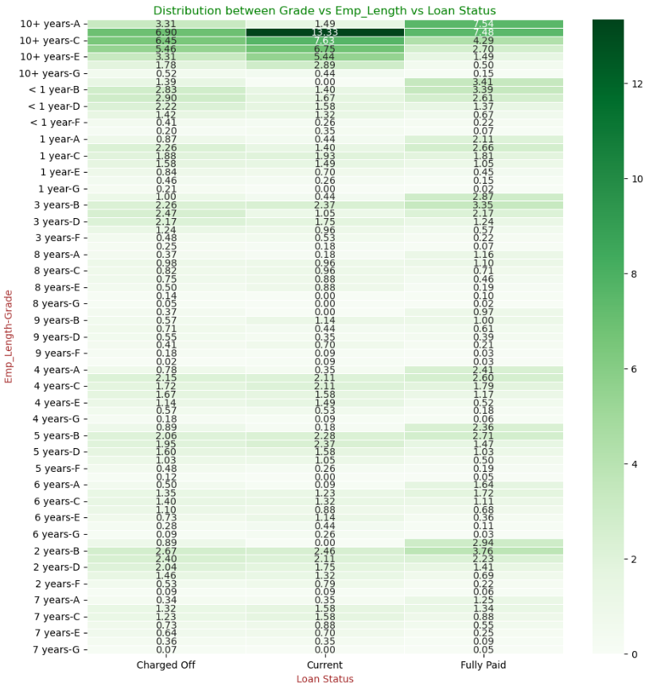
Loan Status Analysis by Grade and Experience
Individuals with 10+ years of experience and a loan grade A show a strong tendency to repay their loans.
These individuals also have a moderate likelihood of being charged off.
For ongoing loans, individuals with 10+ years of experience and loan grades C, E, or G are riskier and more likely to default, as historical data shows a higher charge-off percentage compared to those who have repaid their loans.

Slide 22
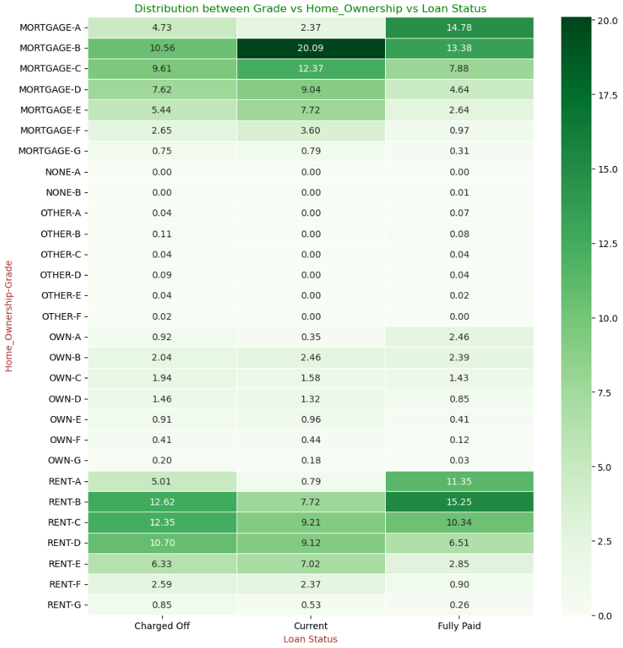
Loan Status Analysis by Grade and Home Ownership
Individuals who rent and have a loan grade B show a strong tendency to repay their loans but also have a moderate likelihood of being charged off.
Ongoing loans for individuals with loan grades B to E who have a mortgage are riskier and more likely to default.
Ongoing loans for individuals with loan grades C to E who rent are also at a higher risk of default.

Slide 23
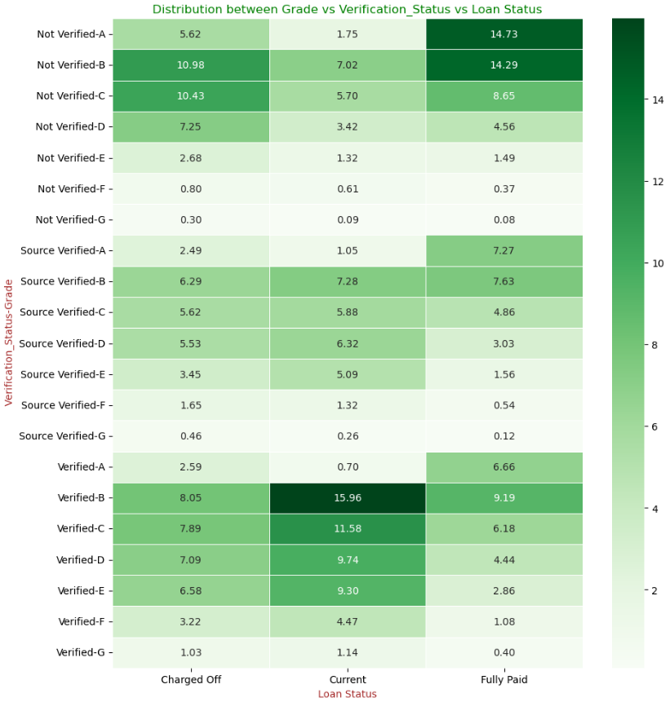
Loan Status Analysis by Grade and Verification Status
Individuals who are not verified and have loan grades A or B show a strong trend to repay their loans.
Non-verified individuals with loan grades B or C are most likely to be charged off.
For ongoing loans, individuals with loan grades C, D, or E who are source verified are at higher risk of default.
Individuals with loan grades C, D, or E, regardless of verification status, are also more likely to default.

Slide 24
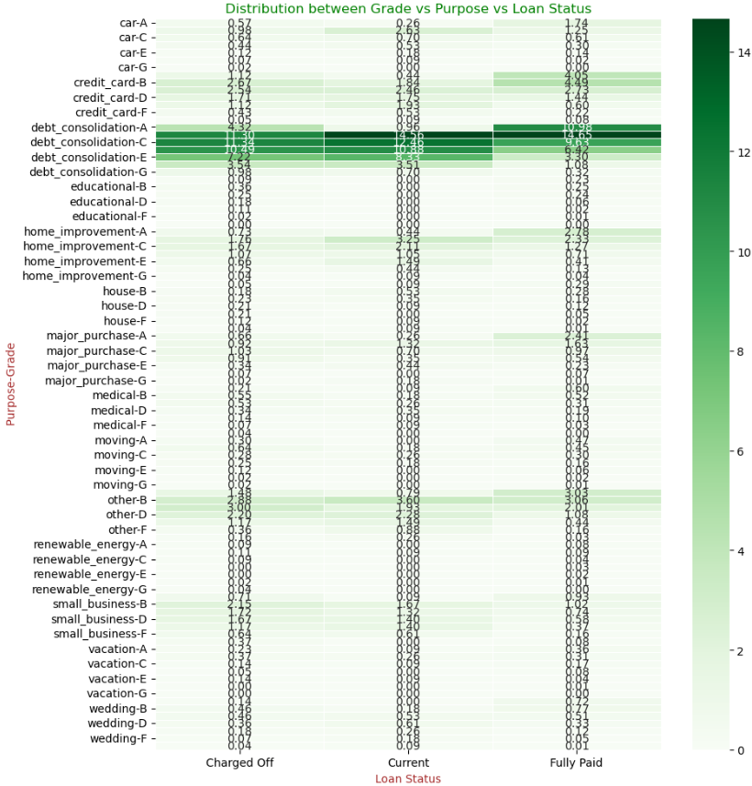
Loan Status Analysis by Grade and Purpose
Individuals who applied for debt consolidation with loan grade A show a strong tendency to repay their loans.
Those who applied for debt consolidation with loan grade C have a moderately strong likelihood of being charged off.
For ongoing loans, individuals with loan grade A for debt consolidation are highly likely to repay their loans.
Loan grades C, E, and G for debt consolidation are riskier and more likely to result in default.

Slide 25
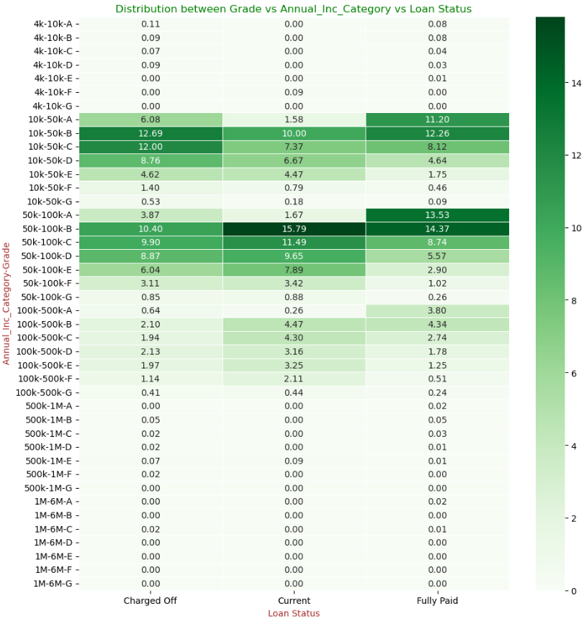
Loan Status Analysis by Grade and Annual Income
Individuals earning 50k-100k with loan grade B are most likely to repay their loans.
Individuals earning 10k-50k with loan grade B are most likely to be charged off.
For ongoing loans, individuals with loan grade B earning 50k-100k are most likely to repay their loans.
Loan grades C, D, and E with earnings of 50k-100k are riskier and more likely to default.

Slide 26
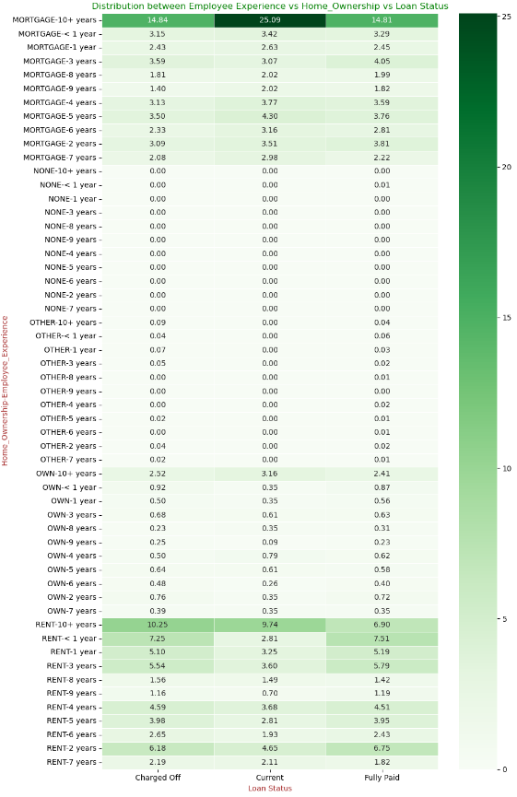
Loan Status Analysis by Employee Experience and Home Ownership
Individuals with over 10 years of experience who own a home with a mortgage show a strong tendency to repay their loans but also have a strong likelihood of being charged off.
For ongoing loans, individuals with over 10 years of experience who are renting are the riskiest and most likely to default.
There is also a small possibility that individuals with over 10 years of experience and a mortgage may get charged off.

Slide 27
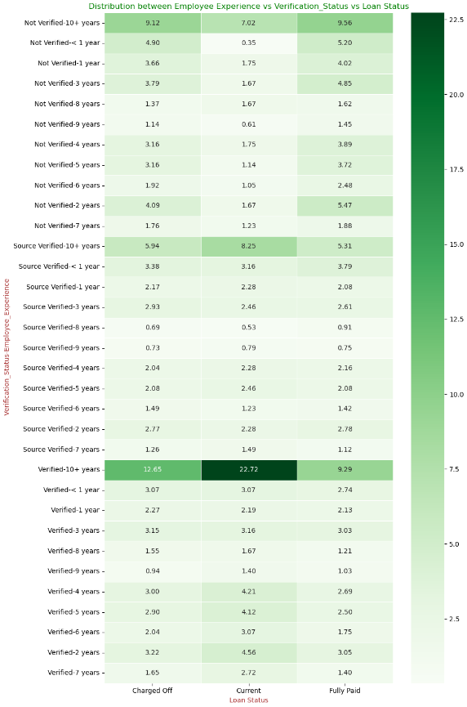
Loan Status Analysis by Employee Experience and Verification Status
Individuals who are not verified and have over 10 years of experience show a strong trend to repay their loans.
Verified individuals with over 10 years of experience show a strong trend toward being charged off.
For ongoing loans, verified individuals with over 10 years of experience are the riskiest and most likely to default.

Slide 28
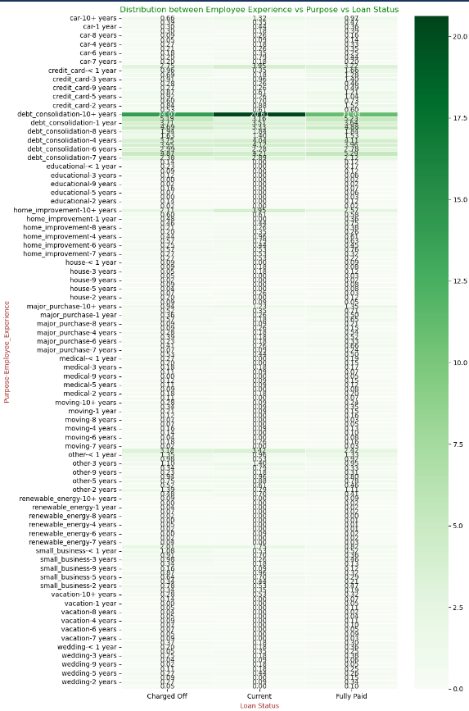
Loan Status Analysis by Employee Experience and Purpose
Individuals with over 10 years of experience who apply for debt consolidation loans are most likely to be charged off, though they also show a moderate likelihood of repaying the loan.
For ongoing loans, individuals with over 10 years of experience who apply for debt consolidation are riskier and more likely to default.

Slide 29
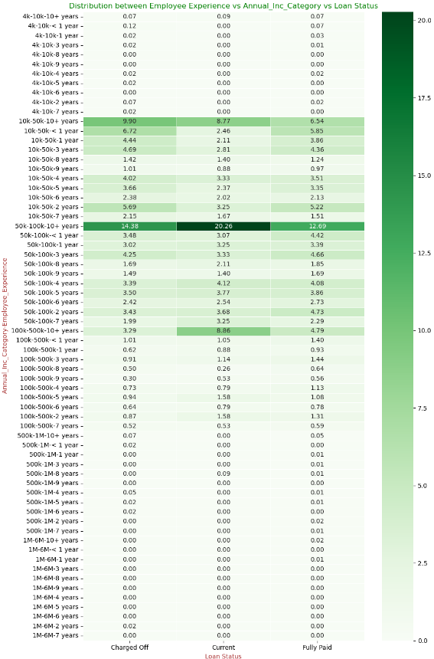
Loan Status Analysis by Employee Experience and Annual Income
Individuals earning 50k-100k with over 10 years of experience are less likely to repay their loans and have a strong likelihood of being charged off.
For ongoing loans, individuals with over 10 years of experience and an annual income of 50k-100k are riskier.
These individuals are most likely to be charged off, indicating a higher risk of default.

Slide 30
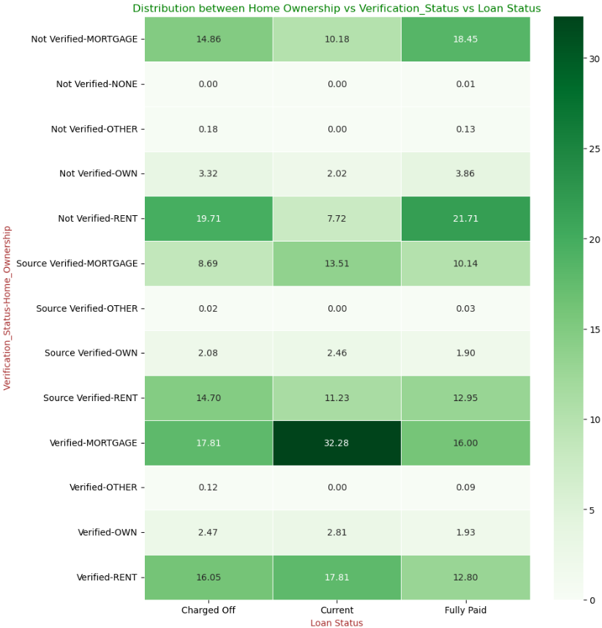
Loan Status Analysis by Home Ownership and Verification Status
Individuals who are not verified and are renting show a strong tendency to repay their loans but also have a strong likelihood of being charged off.
For ongoing loans, individuals who are verified and have a mortgage or are renting are riskier.
These verified individuals are most likely to default on their loans.

Slide 31
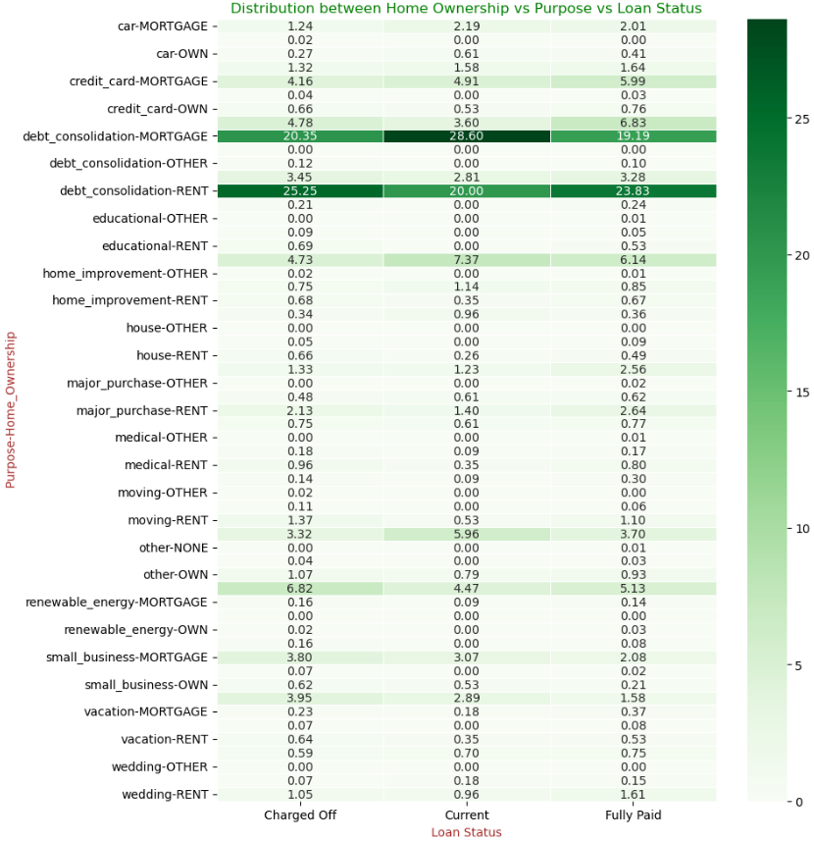
Loan Status Analysis by Home Ownership and Purpose
Individuals who have applied for debt consolidation and are renting show a strong tendency to repay their loans but also have a strong likelihood of being charged off.
For ongoing loans, individuals who are renting and took a loan for debt consolidation are more likely to default.
Individuals with a mortgage who took a loan for debt consolidation have a small probability of defaulting.

Slide 32
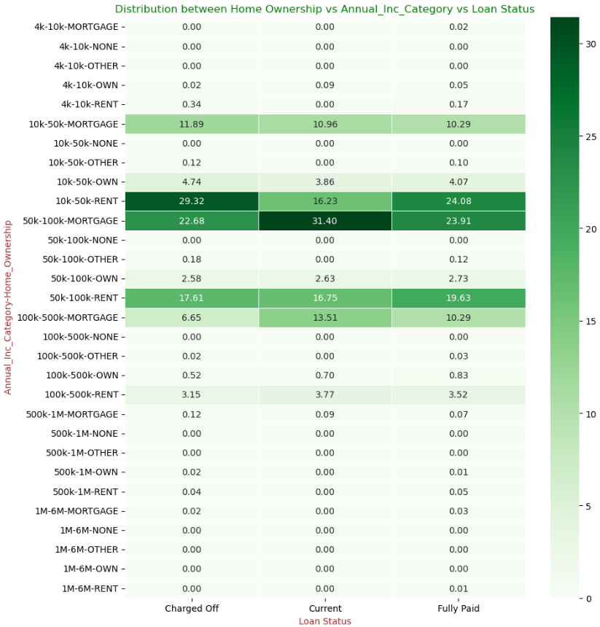
Loan Status Analysis by Home Ownership and Annual Income
Individuals earning 50k-100k (rented) are likely to repay the loan but also have a strong likelihood of experiencing a charge-off.
Individuals earning 10k-50k (rented) are riskier and more likely to default on the loan.

Slide 33
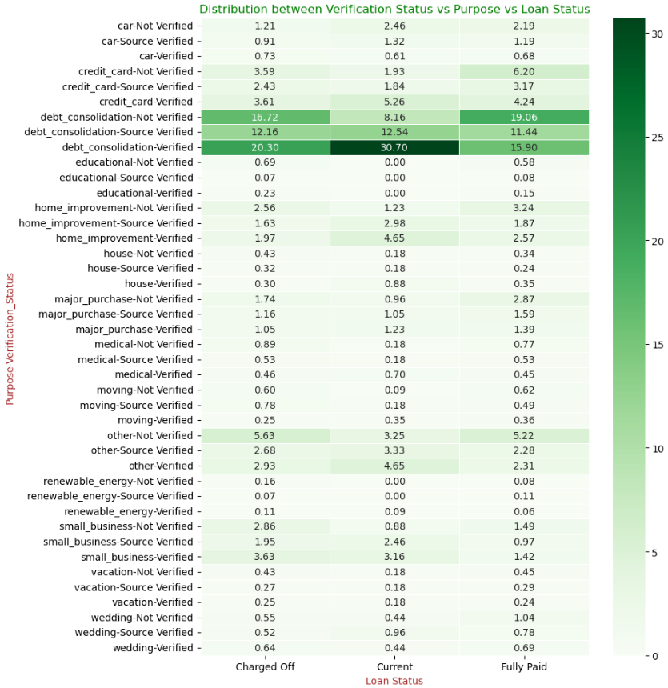
Loan Status Analysis by Verification Status and Purpose
Individuals who took a loan for debt consolidation and are not verified show a stronger tendency to repay the loan.
Individuals who applied for debt consolidation and are verified are more likely to be charged off.
Verified individuals with ongoing loans for debt consolidation are riskier and more likely to default.

Slide 34
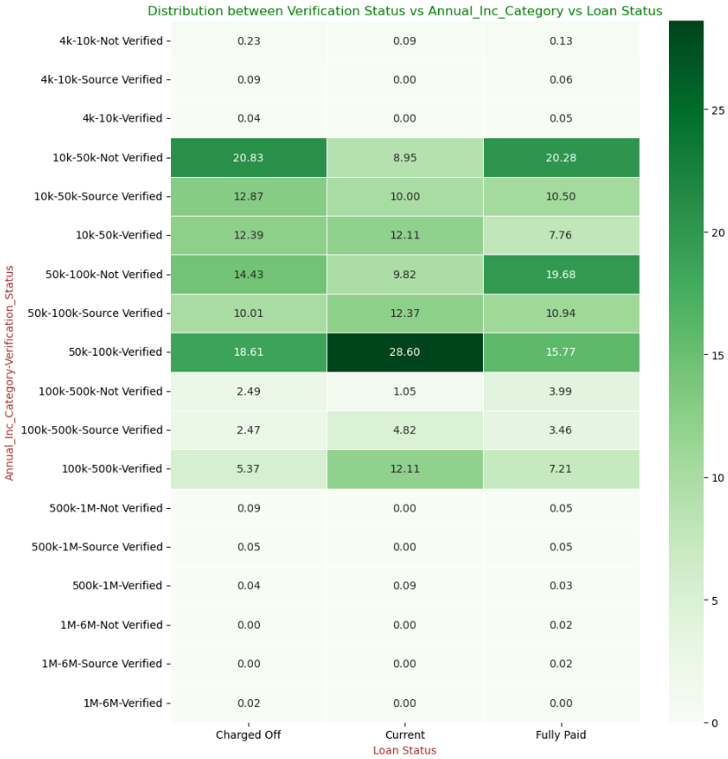
Loan Status Analysis by Verification Status and Annual Income
Individuals with an annual income of 10k-50k and 50k-100k (not verified) show a stronger tendency to repay the loan.
However, individuals with an income of 10k-50k (not verified) also have a strong likelihood of being charged off.
Verified individuals with ongoing loans and an income of 10k-100k are riskier and more likely to default.
Source-verified individuals with an income of 10k-50k are also considered riskier and likely to default.

Slide 35
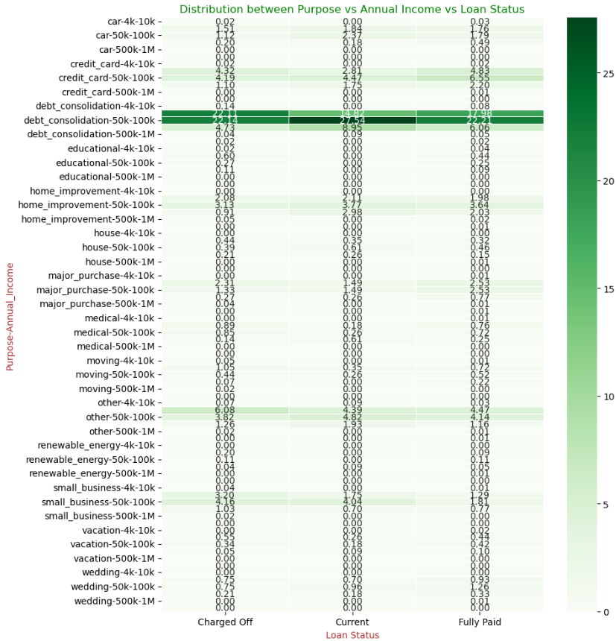
Loan Status Analysis by Purpose and Loan Amount
Individuals earning 50k-100k who took a loan for debt consolidation tend to repay the loan.
Despite this, they also have a strong likelihood of being charged off.
Individuals with ongoing loans for debt consolidation and an annual income of 4k-10k are riskier and more likely to default

Slide 36
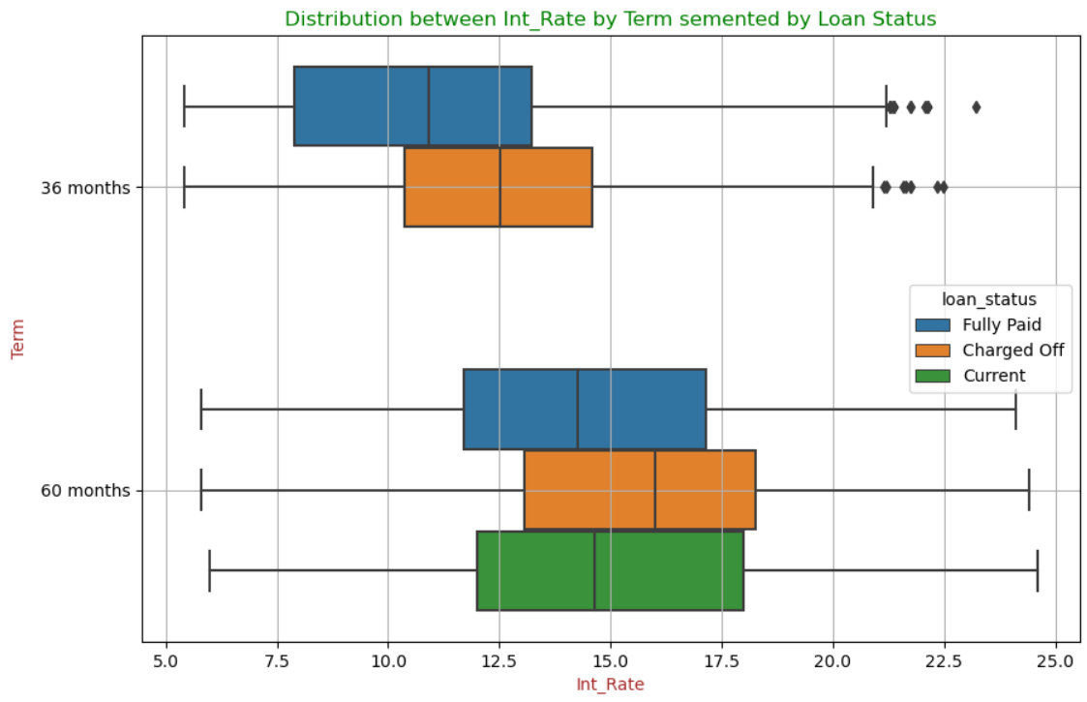
Loan Status Analysis by Interest Rate and Term
Loans with a 36-month term typically have lower interest rates compared to 60-month term loans.
"Charged Off" loans generally carry slightly higher interest rates than "Fully Paid" and "Current" loans, indicating a potential link between higher interest rates and loan default risk.
Loans with higher interest rates, especially those with 60-month terms, are riskier and have a higher likelihood of default.

Slide 37
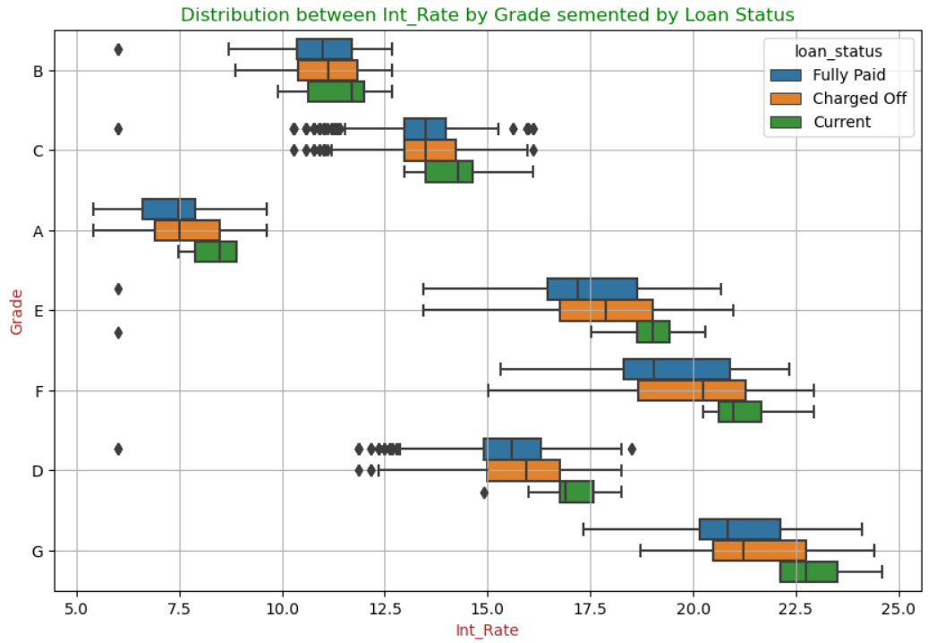
Loan Status Analysis by Interest Rate and Grade
Lower-grade loans (D, E, F, G) usually come with higher interest rates compared to higher-grade loans (A, B, C).
"Charged Off" loans across most grades tend to have slightly higher interest rates, suggesting a correlation between higher rates and default risk.
The interest rate spread widens with lower-grade loans, reflecting greater variability and risk.
Approving lower-grade loans with high interest rates is riskier, as they are more likely to result in defaults due to this increased variability.

Slide 38
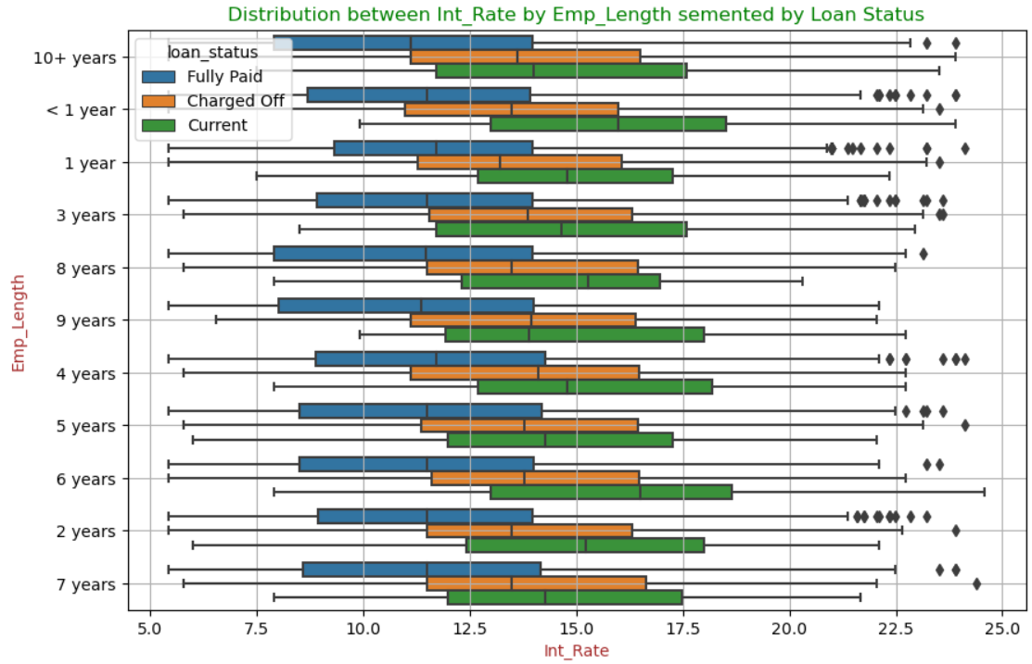
Loan Status Analysis by Interest Rate and Employee Experience
Interest rates remain consistent across different lengths of employee experience, with no significant variation based on employment duration.
"Charged Off" loans tend to have slightly higher interest rates across most employment lengths, indicating a possible link between higher interest rates and default risk.
The spread of interest rates is similar across all employment lengths, suggesting that employment duration doesn't significantly affect interest rate variability.
Despite employment length not impacting risk, loans with higher interest rates are inherently riskier, regardless of how long someone has been employed.

Slide 39
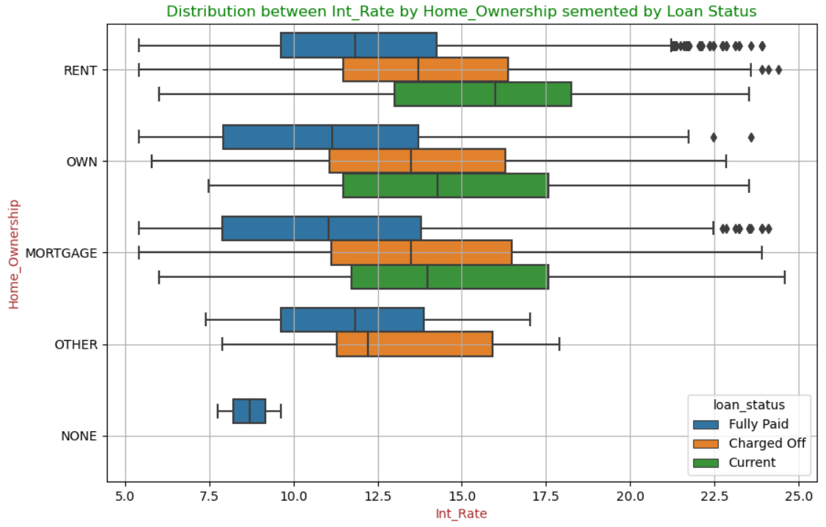
Loan Status Analysis by Interest Rate and Home Ownership
Interest rates remain consistent across different home ownership types, with no significant variation based on the type of home.
"Charged Off" loans typically have slightly higher interest rates across all home ownership categories, indicating a possible connection between higher rates and default risk.
Interest rate variation is similar across all home ownership types, suggesting that home ownership does not significantly impact interest rate differences.
Issuing loans with higher interest rates is risky across all home ownership categories, as these rates are associated with a higher likelihood of default.

Slide 40
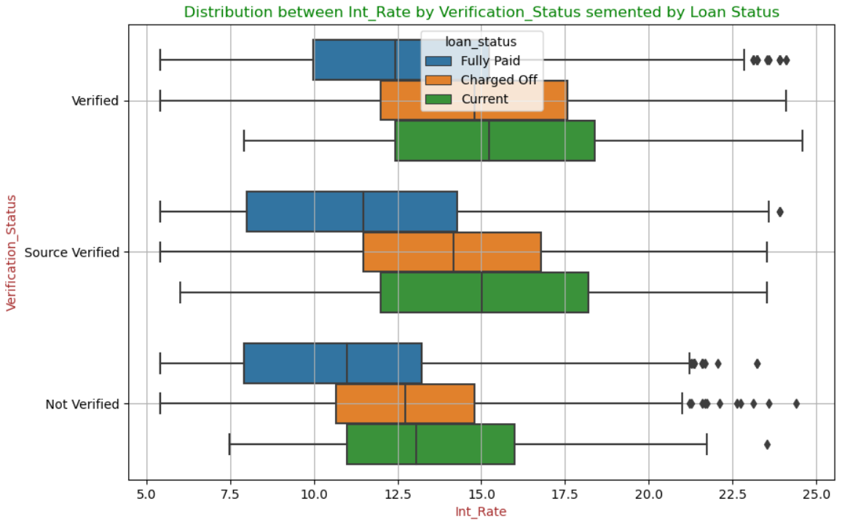
Loan Status Analysis by Interest Rate and Verification Status
Verification status strongly influences loan outcomes, with verified loans showing higher full repayment rates and lower charged-off rates.
Verified loans typically come with lower interest rates, indicating reduced risk compared to source verified or not verified loans.
Lending to verified individuals at lower interest rates is less risky, as verification is linked to better repayment behavior.

Slide 41
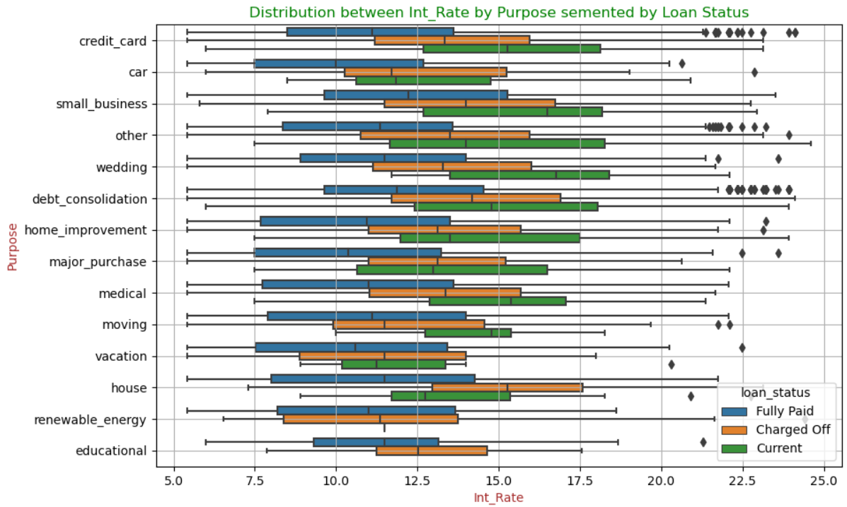
Loan Status Analysis by Interest Rate and Purpose
Interest rates differ across loan purposes, with car loans generally having the lowest rates and home loans higher rates.
"Charged Off" loans typically have higher interest rates across all purposes, indicating a link between higher rates and default risk.
Loan purposes with higher interest rates, such as home improvement or small business, are riskier and more likely to default.

Slide 42
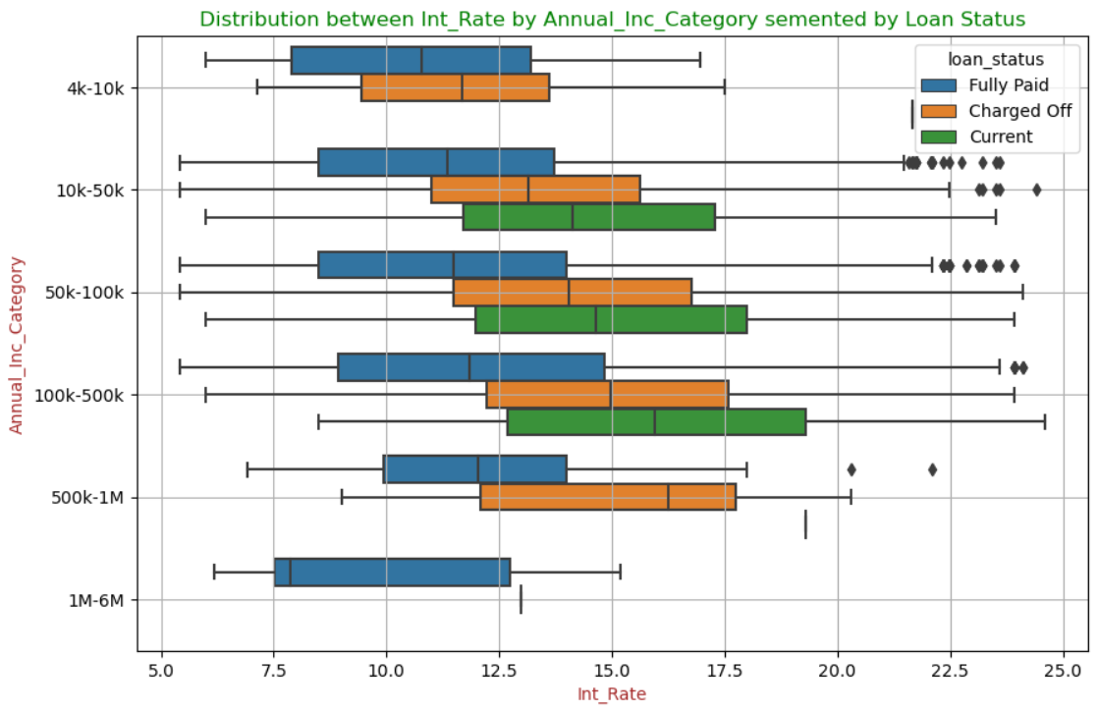
Loan Status Analysis by Interest Rate and Annual Income
Interest rates generally rise with annual income, except within the 1M-6M range, where they stabilize.
"Charged Off" loans consistently have higher interest rates across all income levels, indicating a link between higher rates and default risk.
Loans with higher interest rates are riskier across all income ranges, with increased default risk, particularly in lower income brackets.

Slide 43
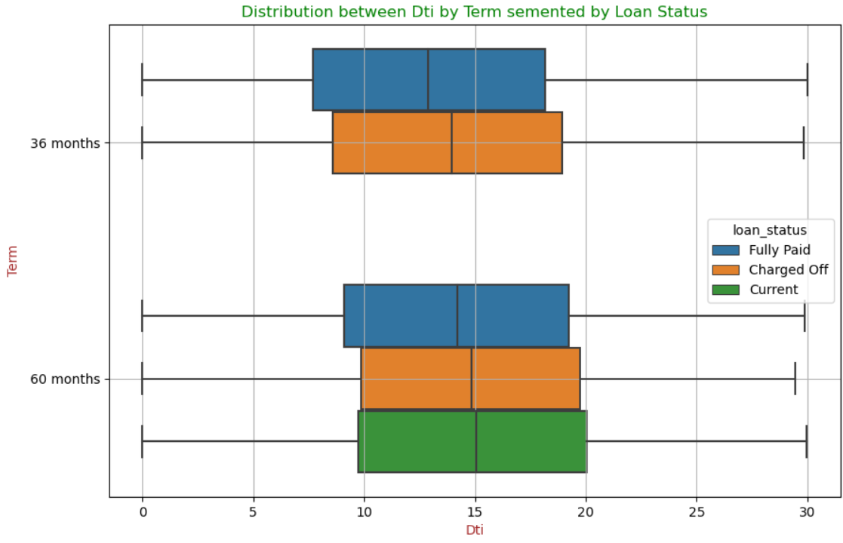
Loan Status Analysis by Debt to Income Ratio (DTI) and Term
Loans with a 36-month term typically have lower DTI ratios compared to 60-month term loans.
"Charged Off" loans generally exhibit higher DTI ratios across both terms, indicating a link between higher DTI and default risk.
Approving loans with higher DTI ratios, particularly for 60-month terms, is riskier due to the increased likelihood of default.

Slide 44
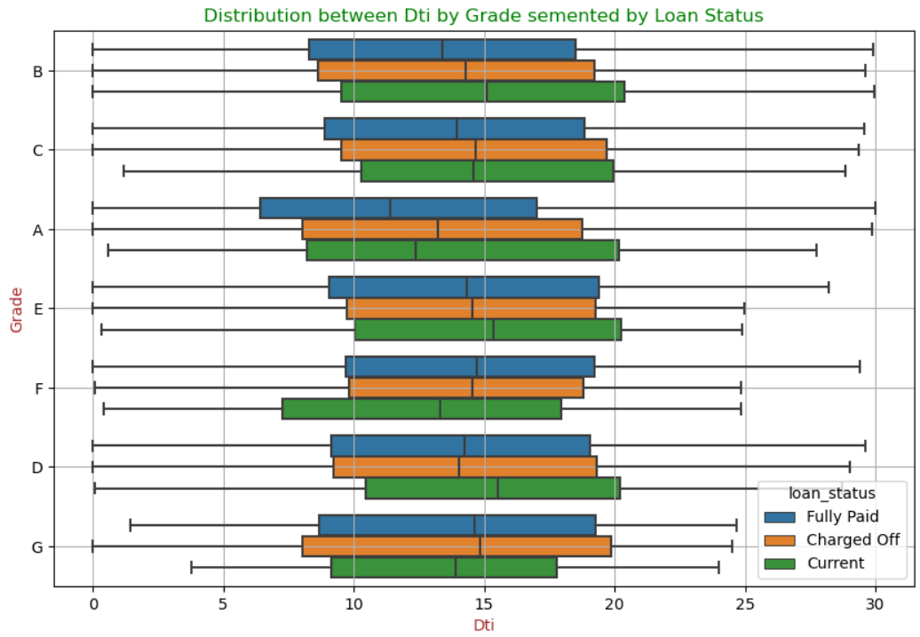
Loan Status Analysis by Debt to Income Ratio (DTI) and Grade
DTI ratio distribution is consistent across loan grades for fully paid, charged-off, and current loans.
Lower loan grades (E, F, G) show a wider DTI range, especially for charged-off loans, indicating higher variability and risk.
Approving lower-grade loans with higher DTI ratios is riskier due to increased variability and a higher chance of default.

Slide 45
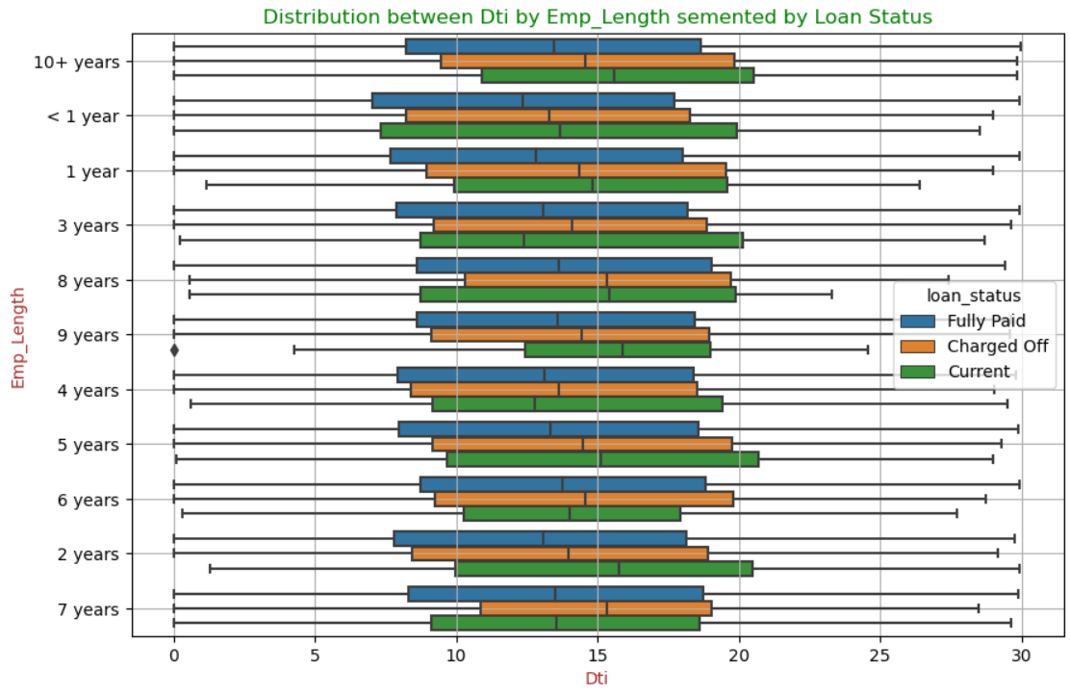
Loan Status Analysis by Debt to Income Ratio (DTI) and Employee Experience
DTI ratio distribution is consistent across different employment lengths for fully paid, charged-off, and current loans.
There is no significant correlation between employment length and DTI ratio or loan outcomes, indicating that employment length is not a strong predictor of loan performance.
While employment experience has little impact on DTI risk, loans with higher DTI ratios are still considered risky.

Slide 46
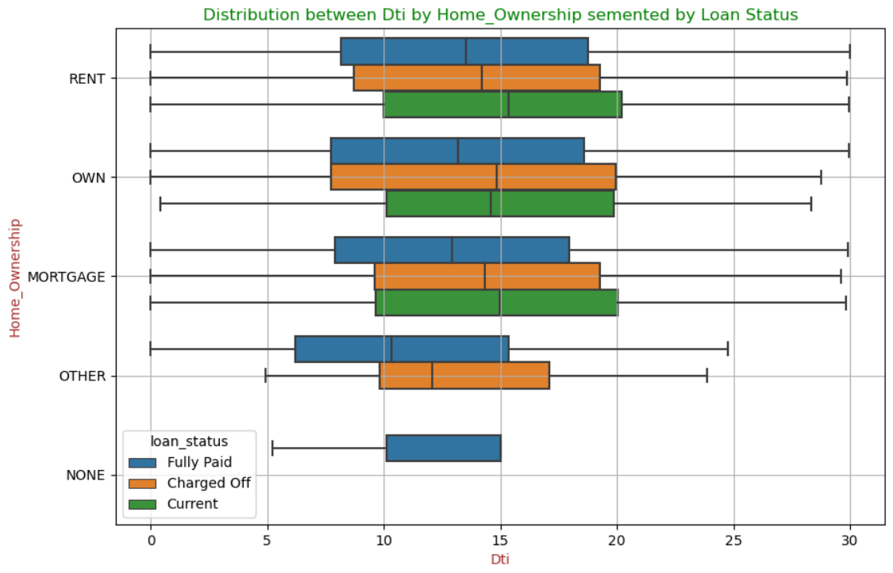
Loan Status Analysis by Debt to Income Ratio (DTI) and Home Ownership
Renters and mortgage holders exhibit a wider range of DTI ratios, especially among those who are fully paid or charged off.
Borrowers who own their homes or have no listed ownership type generally show more concentrated DTI distributions.
This indicates that home ownership status, particularly renting or mortgaging, may contribute to higher variability in DTI ratios and potential risk in loan outcomes.
Approving loans for renters or those with mortgages with higher DTI ratios may be riskier due to the greater variability and higher default risks associated with these groups.

Slide 47
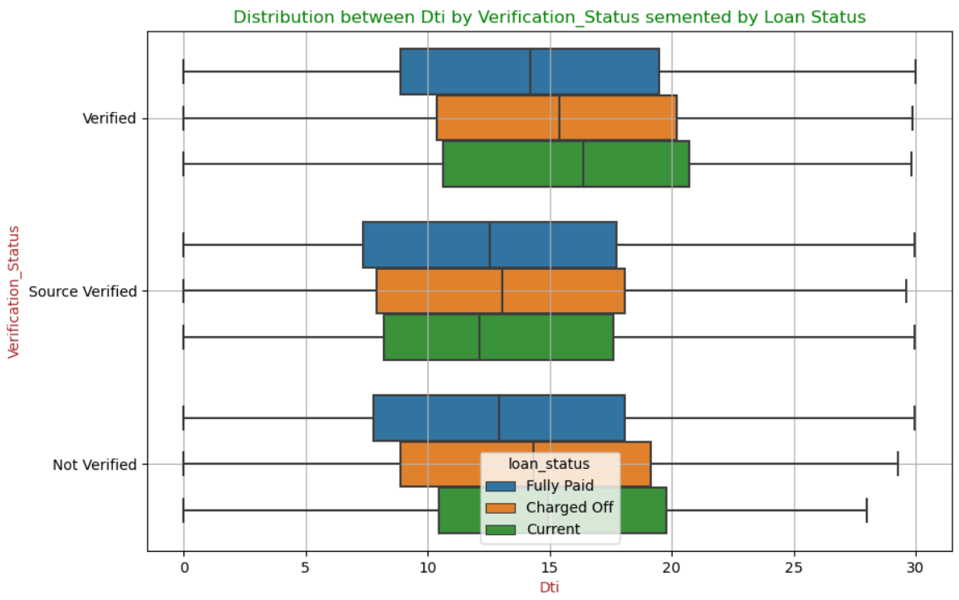
Loan Status Analysis by Debt to Income Ratio (DTI) and Verification Status
Verified loans have a higher proportion of fully paid loans and lower charge-off rates compared to non-verified loans.
Verified loans also tend to have higher DTI levels compared to non-verified loans.
This indicates that verification status is a strong indicator of loan repayment behavior.
Approving verified loans with higher DTI ratios may be less risky because verification suggests a greater likelihood of repayment.
Approving non-verified loans may be riskier due to the higher likelihood of default.

Slide 48
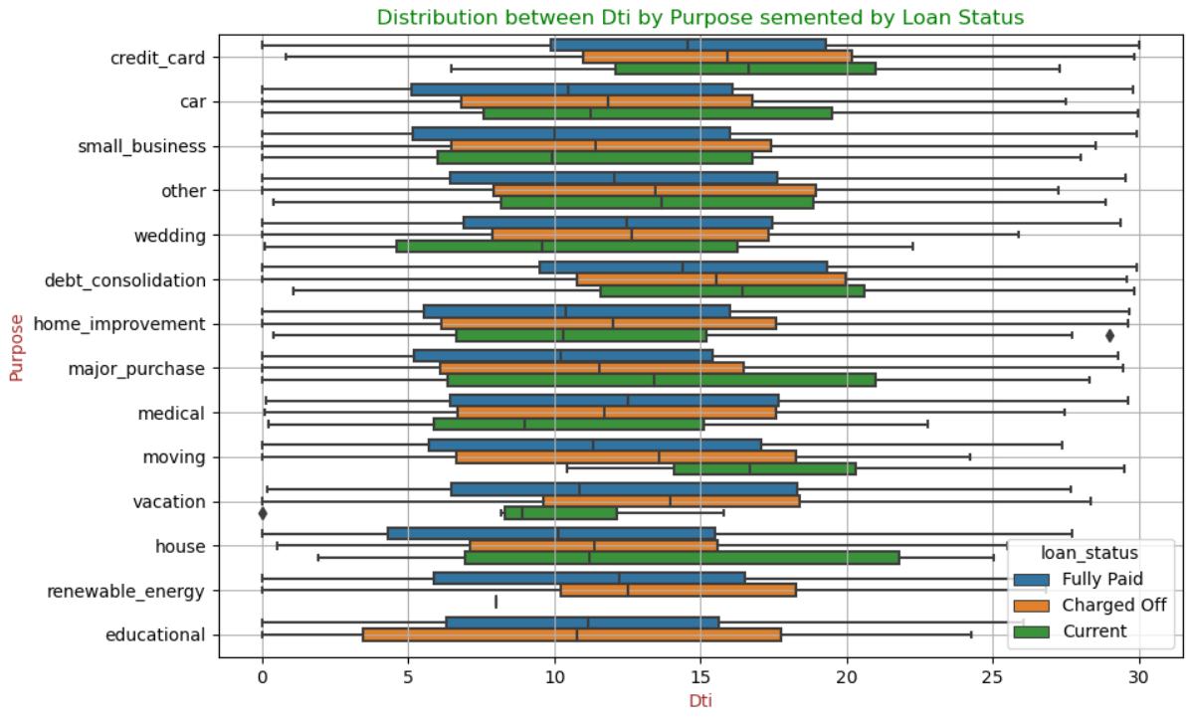
Loan Status Analysis by Debt to Income Ratio (DTI) and Purpose
Loans with higher DTI ratios are more likely to be charged off or remain current compared to fully paid loans for most purposes.
Debt consolidation and small business loans have a wider range of DTI ratios, indicating higher risk variability.
Approving loans with higher DTI ratios for debt consolidation and small business purposes may be riskier due to the higher likelihood of default.

Slide 49
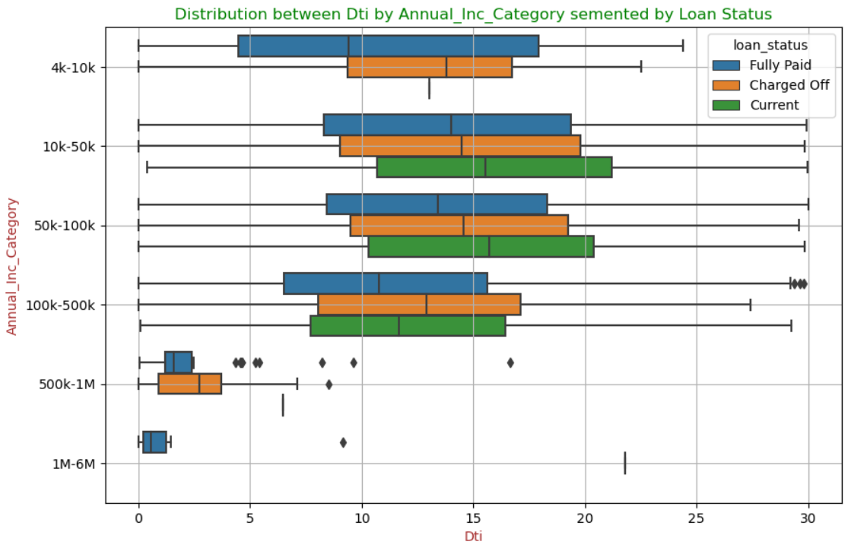
Loan Status Analysis by Debt to Income Ratio (DTI) and Annual Income
Higher income categories are more likely to have lower DTI ratios and higher proportions of fully paid loans.
Lower income categories tend to have higher DTI ratios and higher proportions of charged-off loans.
This suggests that income category is a significant factor in loan repayment behavior, particularly when considering DTI ratios.
Approving loans with higher DTIs, especially for lower income brackets, may be riskier due to the increased likelihood of default..

Slide 50
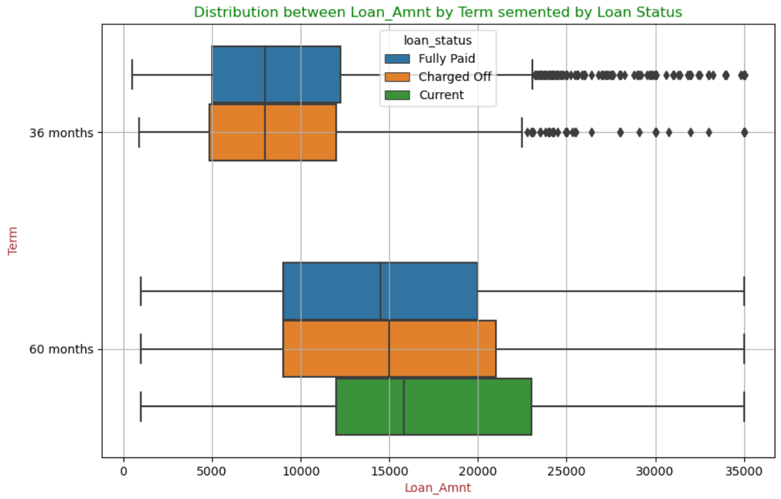
Loan Status Analysis by Loan Amount and Term
Longer loan terms are often associated with larger loan amounts.
Larger loan amounts are more likely to result in "Charged Off" loans, especially for longer terms.
This suggests that approving larger loan amounts for longer terms may be riskier due to the increased likelihood of default.

Slide 51
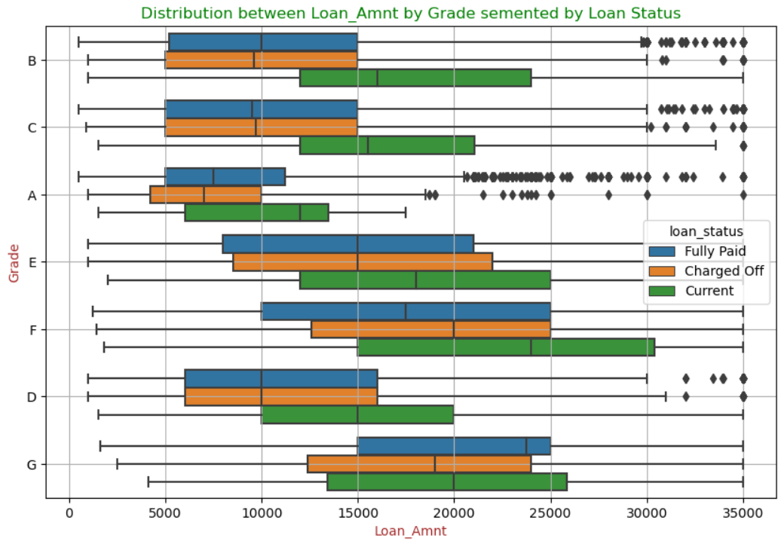
Loan Status Analysis by Loan Amount and Grade
Lower-grade loans (e.g., D, E, F, G) often involve larger loan amounts compared to higher-grade loans (e.g., A, B, C).
Lower-grade loans (especially E, F, G) are more likely to be charged off.Current loans in lower-grade categories tend to have larger amounts.
Lower-grade loans have more variability in loan amounts, indicating higher risk and diverse borrowing behaviors.
Approving larger loan amounts for lower-grade loans (D, E, F, G) may be riskier due to the increased likelihood of default

Slide 52
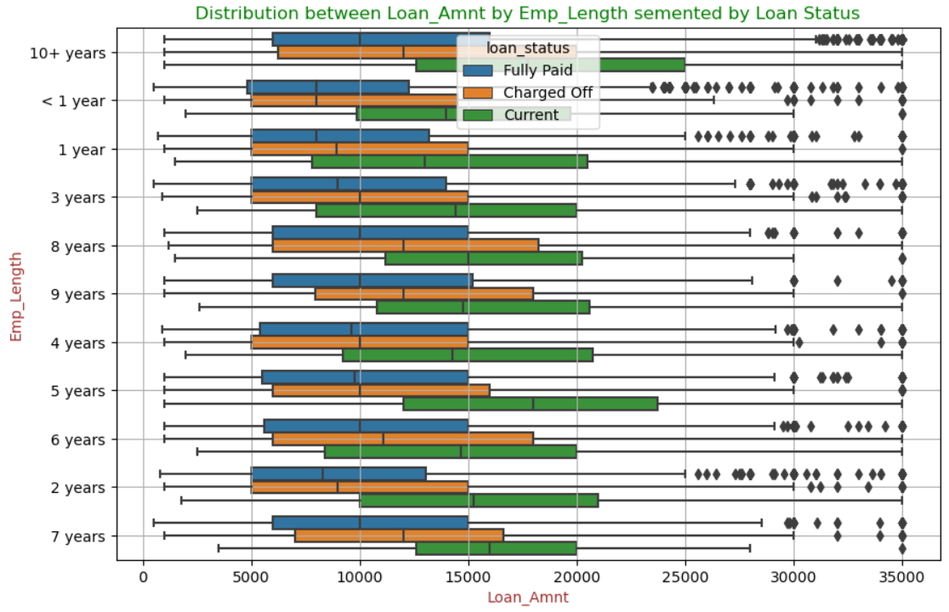
Loan Status Analysis by Loan Amount and Employee Experience
Employment length does not significantly impact loan amounts.
"Charged Off" loans occur similarly across all employment lengths.
Employment length does not strongly influence the risk of default.
Larger loan amounts remain risky, regardless of employment length.

Slide 53

Loan Status Analysis by Loan Amount and Home Ownership
Homeowners tend to borrow more than renters.
Home ownership status does not significantly impact the risk of default.
Larger loan amounts remain risky, regardless of home ownership status.
Approving larger loan amounts for homeowners or those with mortgages may be riskier due to the correlation between larger loans and higher default risks

Slide 54

Loan Status Analysis by Loan Amount and Verification Status
Verification status influences loan amounts.
Verified loans have higher proportions of both fully paid and charged-off loans.
Verification status alone may not fully predict repayment behavior.
Approving verified loans may be less risky overall, but caution is needed with larger amounts due to the potential for higher default rates.

Slide 55

Loan Status Analysis by Loan Amount and Purpose
"Charged Off" loans typically have more variability in loan amounts than "Fully Paid" loans for most loan purposes.
"Moving" loans are an exception, with "Charged Off" loans having less variability than "Fully Paid" loans.
Higher variability in loan amounts may indicate higher risk of loan default, especially for purposes like debt consolidation.
Approving larger loan amounts for debt consolidation may be riskier due to the potential for higher variability and increased likelihood of default.

Slide 56

Loan Status Analysis by Loan Amount and Term
Loan amounts generally increase with higher annual income, except within the 1M-6M income range.
"Charged Off" loans occur similarly across income categories, suggesting that higher income does not guarantee lower default risk.
Higher income categories have more variability in loan amounts, indicating greater risk and fluctuation in repayment outcomes.
Approving larger loan amounts may be riskier even for higher income categories due to the increased variability and potential for default.

